Slide 1
Let's Go Premium!
The Essentials to Kickstart Your Experience
Notes:
Just a quick raise of hands: first question is easy:
1) who is not already using Power BI?
2) Who has access to Premium capacity, or is planning on having access soon?
3) Who is familiar with Analysis Services (in Azure or on-prem)?
You know how I got the idea to present a session about Power BI Premium? It’s because of one of the questions I get asked most often these days…

Slide 2

Which ‘data flow’ are you talking about..?
Notes:
Besides this question of course: “Which data flow solution are you talking about?” ADF / Power BI.. ? SSIS…?
It was about the question.. CLICK..

Slide 3

Should I use Power BI Premium or Analysis Services?
Notes:
“What is the difference between Power BI Premium and Azure Analysis Services, and how do I select the service that fits my needs best?”
The answer to this question is of course… (antwoord uit publiek).. CLICK. “it depends” ☺.
No I’m going to give you some absolute guidelines, no worries.
But first I promised to give you the essentials on Power BI Premium!

Slide 4
Agenda
What is Power BI Premium?
Under the hood of Power BI Premium
Power BI Premium management
Comparison to Azure Analysis Services
Roadmap
Notes:
In this deep-dive session you will learn: <list agenda>.
If the demo gods are in a good mood I’ll demo some nice things along the way.
If you want to skip this session, that’s totally fine by me. No hard feelings. For the folks that stay, I’m happy with this going to be an interactive session.
If you have a question, don’t hesitate to ask right away.

Slide 5




Dave Ruijter
Data & AI Consultant
Macaw Netherlands
dave.ruijter@macaw.nl
@DaveRuijter daveruijter
moderndata.ai
Notes:
My name is Dave Ruijter and I’d love it if you tag me in your social media posts on this session!
Don’t forget to use #PowerPlatformSummit.
I’m a blogger on all kinds of Azure and Power Platform related stuff at moderndata.ai.
I’m also the creator of a little Cheat Sheet for Power BI, that you can download for free CLICK

Slide 6
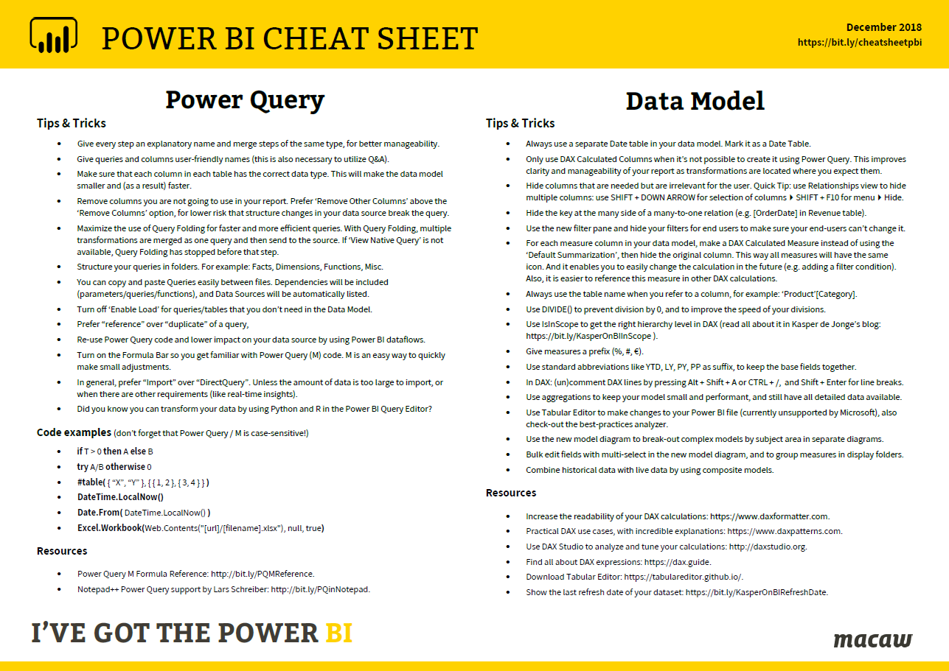
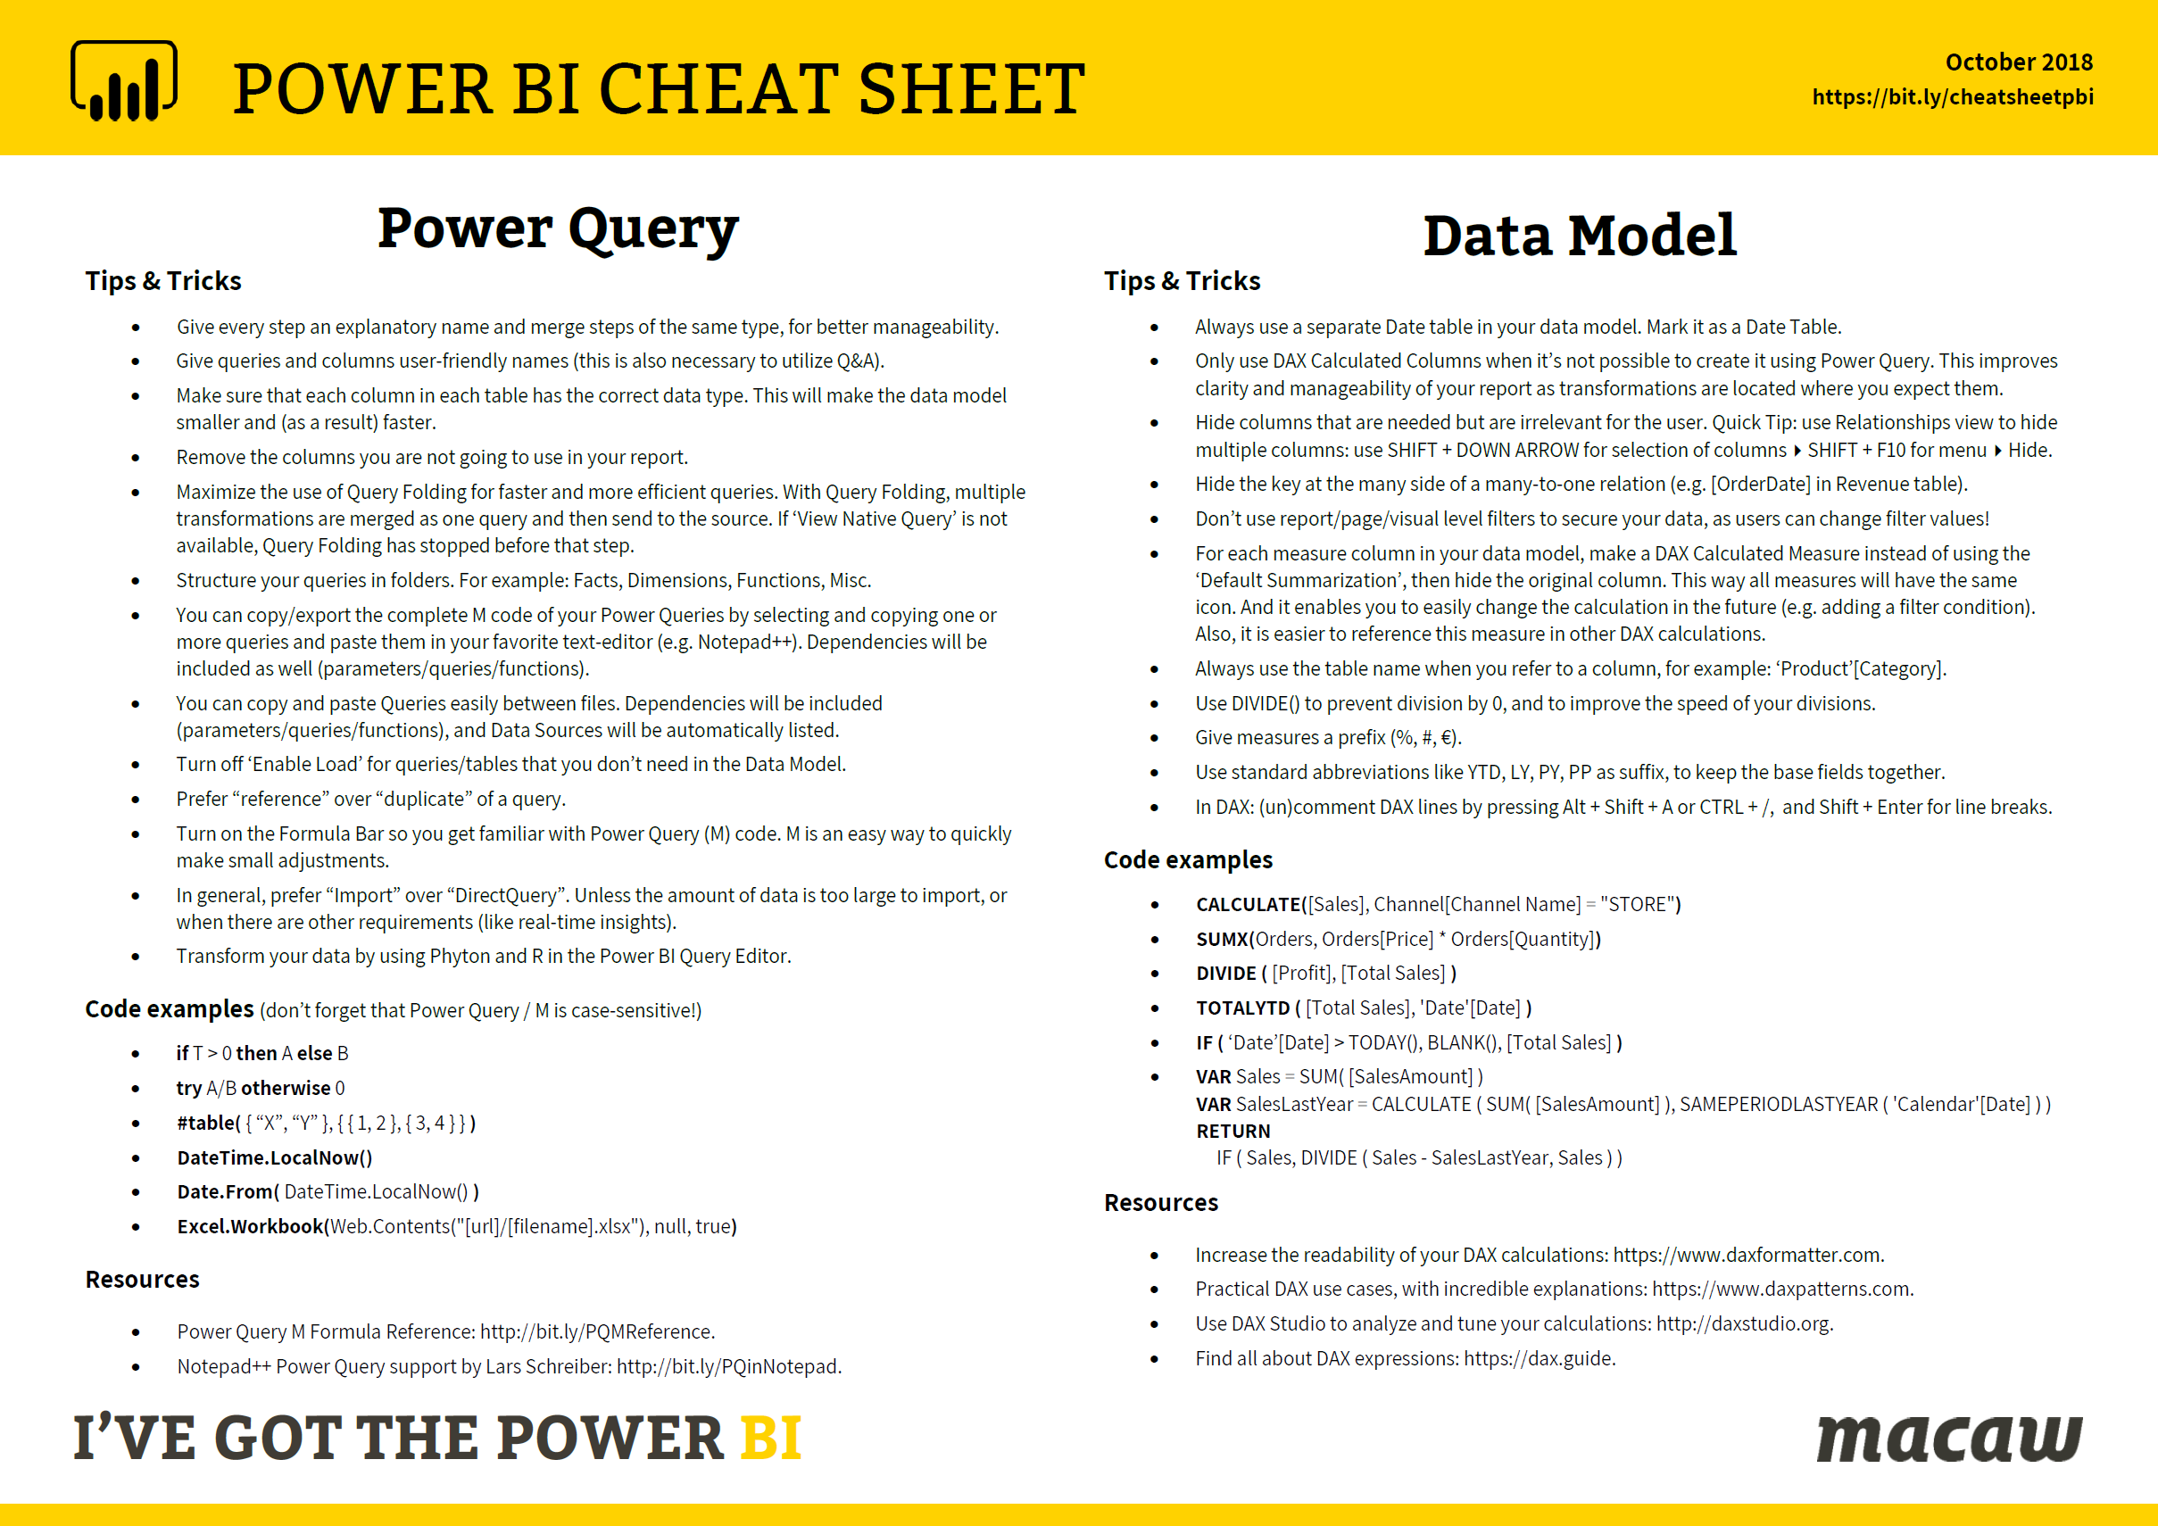

Download for free!
https://bit.ly/cheatsheetpbi
Notes:
And I’ve got a bunch of copies here with me, because I know it sometimes works better to have it on your desk for grabs.
So let’s continue on Power BI Premium!
CLICK

Slide 7
What is... Power BI Premium?
Notes:
Ask audience

Slide 8
What is Power BI Premium?
Power BI
💎
Power BI Premium
💎
Power BI Premium
💎
Power BI Premium
Customer 1
Customers 1, 2, 3, … n
Customer 2
Customer 3
Notes:
Premium is an add-on for Power BI service. Premium is basically your own private server running the Power BI architecture in Azure. To understand why that’s important, it helps to understand the existing architecture for the Power BI.
Currently, Power BI runs on clusters of machines that all of the Power BI customers use. As the capacity must share resources, limitations are imposed to ensure "fair play", such as the maximum model size (1 GB) and maximum daily refresh frequency (eight times per day). With Power BI Premium, all the capacity is yours. Because the capacity of Power BI Premium services belong to you, this allows many of the restrictions and limitations of the Power BI service to be lifted giving you greater control over how resources dedicated to your Power BI service are managed.

Slide 9


What is Power BI Premium?
Self-service BI
users
Enterprise BI
All BI users
💎
Azure
Analysis Services
Power BI
Premium
Power BI

Slide 10
What is Power BI Premium?
Flexibility to license by capacity
Greater scale and performance
Dedicated
resources
in the cloud
Power BI Premium
Extending on-premises capabilities
Embedded
analytics
Notes:
Because Power BI Premium is basically your own private Power BI server, you have flexibility over how those resources are used.
The resources are dedicated to your organization, so this allows you to deliver Power BI content to your organization without having to license every single, individual users.
Also, since the resources are dedicated to your organization, this removes the requirement to license every single user that needs access to your Power BI content. This enabled read access to much larger groups of users than before.
So with Power BI Premium, you can roll out Power BI content to as many users as the capacity you’ve purchased can handle.

Slide 11
P = Power BI Pro license
Power BI Service
Data Sources
Reports
Dashboards
P
P
P
💎 Premium App Workspace
P
P
P
P
P
P
Data Sources
Reports
Dashboards
💎 Premium App Workspace
Power BI developers
P
P
P
Power BI consumers
Notes:
Slide from Dustin Ryan, MSFT.

Slide 12
Four Power BI Service licenses
Power BI Desktop for report authoring & data exploration
Power BI Free for personal self-service BI
Power BI Pro for sharing and collaboration
Power BI Premium for large scale deployments
Notes:
Deze hidden?

Slide 13
What do you get extra?
Share with free users (P1+)
Incremental refresh
48x refresh
Support for larger dataset sizes
XMLA endpoints
Multi-geo
Extra dataflows features (linked entities, parallel execution of transforms, external CDM Folders)
Paginated Reports (SSRS reports)
Ability to embed content in apps on behalf of app users (PaaS)
(now in public preview!)
Notes:
Multi-geo: The rationale for a multi-geo deployment is typically for corporate or government compliance, rather than performance and scale. Report and dashboard loading still involves requests to the home region for metadata.

Slide 14
Demo!
Intro:
Power BI Premium
Notes:
App Workspace backed by dedicated capacity
Admin Portal
Share with free users (eerst PRO license melding, dan niet..)
Paginated Reports (SSRS reports)
XMLA endpoints

Slide 15
Specs
Capacity Node | Total v-cores | RAM | DQ/LC (per sec) | Model Refresh Parallelism | Model Size Limit (GB)
EM1 / A1 | 1 | 2,5 | 3,75 | 1 | 1
EM2 / A2 | 2 | 5 | 7,5 | 2 | 1
EM3 / A3 | 4 | 10 | 15 | 3 | 1
P1 / A4 | 8 | 25 | 30 | 6 | 3
P2 / A5 | 16 | 50 | 60 | 12 | 6
P3 / A6 | 32 | 100 | 120 | 24 | 10
Notes:
All Power BI Premium SKUs are available as capacity nodes, with each representing a set amount of resources consisting of processor, memory and storage.
In addition to resources, each SKU has operational limits on the number of DirectQuery (DQ) and Live Connection (LC) connections per second and the number of parallel model refreshes.
Processing is achieved by a set number of v-cores, divided equally between backend and frontend.
Backend v-cores are responsible for core Power BI functionality, including query processing, cache management, running R services, model refresh, natural language processing (Q&A), and server-side rendering of reports and images. Backend v-cores are assigned a fixed amount of memory which is primary used to host models which are also referred to as active datasets.
Frontend v-cores are responsible for the web service, dashboard and report document management, access rights management, scheduling, APIs, uploads and downloads, and generally for everything relating to the user experiences.
Storage is set to 100 TB per capacity node.
Azure Power BI Embedded and the Premium EM SKU are out of scope of this session.

Slide 16
Power BI Premium notes
To leverage distribution to ‘Free’ users, use Apps
Access to App Workspaces always require Pro license
You can use Azure Power BI Embedded Capacity, but there is no sharing to ‘Free’ users!

Slide 17
Power BI Premium Incremental refresh
Notes:
Ask audience

Slide 18
Incremental refresh
Enable large models in Power BI
Faster refresh
More reliable
Lower CPU and Memory usage
Define policy in Power BI Desktop; apply it in the service
Policy doesn’t affect data in Power BI Desktop

Slide 19
XMLA endpoints
Notes:
Ask audience
ToDo: kijken of ik hier een meme of zo in kan krijgen “yeah imma need to ask you to..”

Slide 20
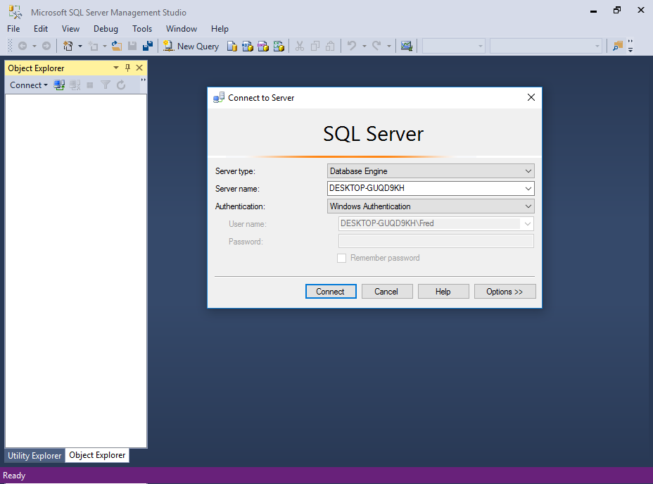
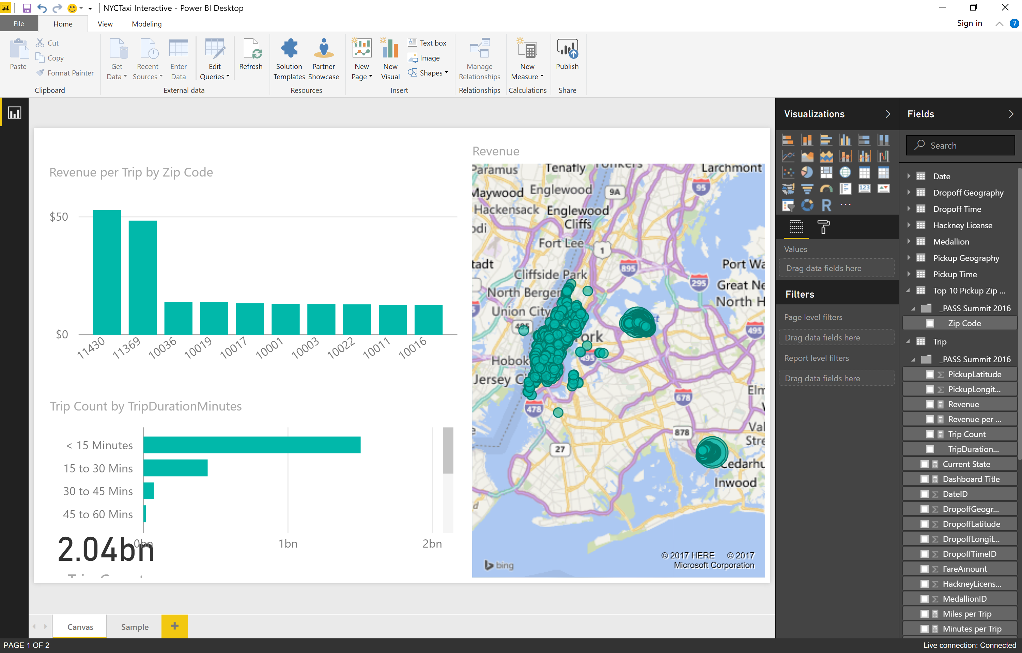

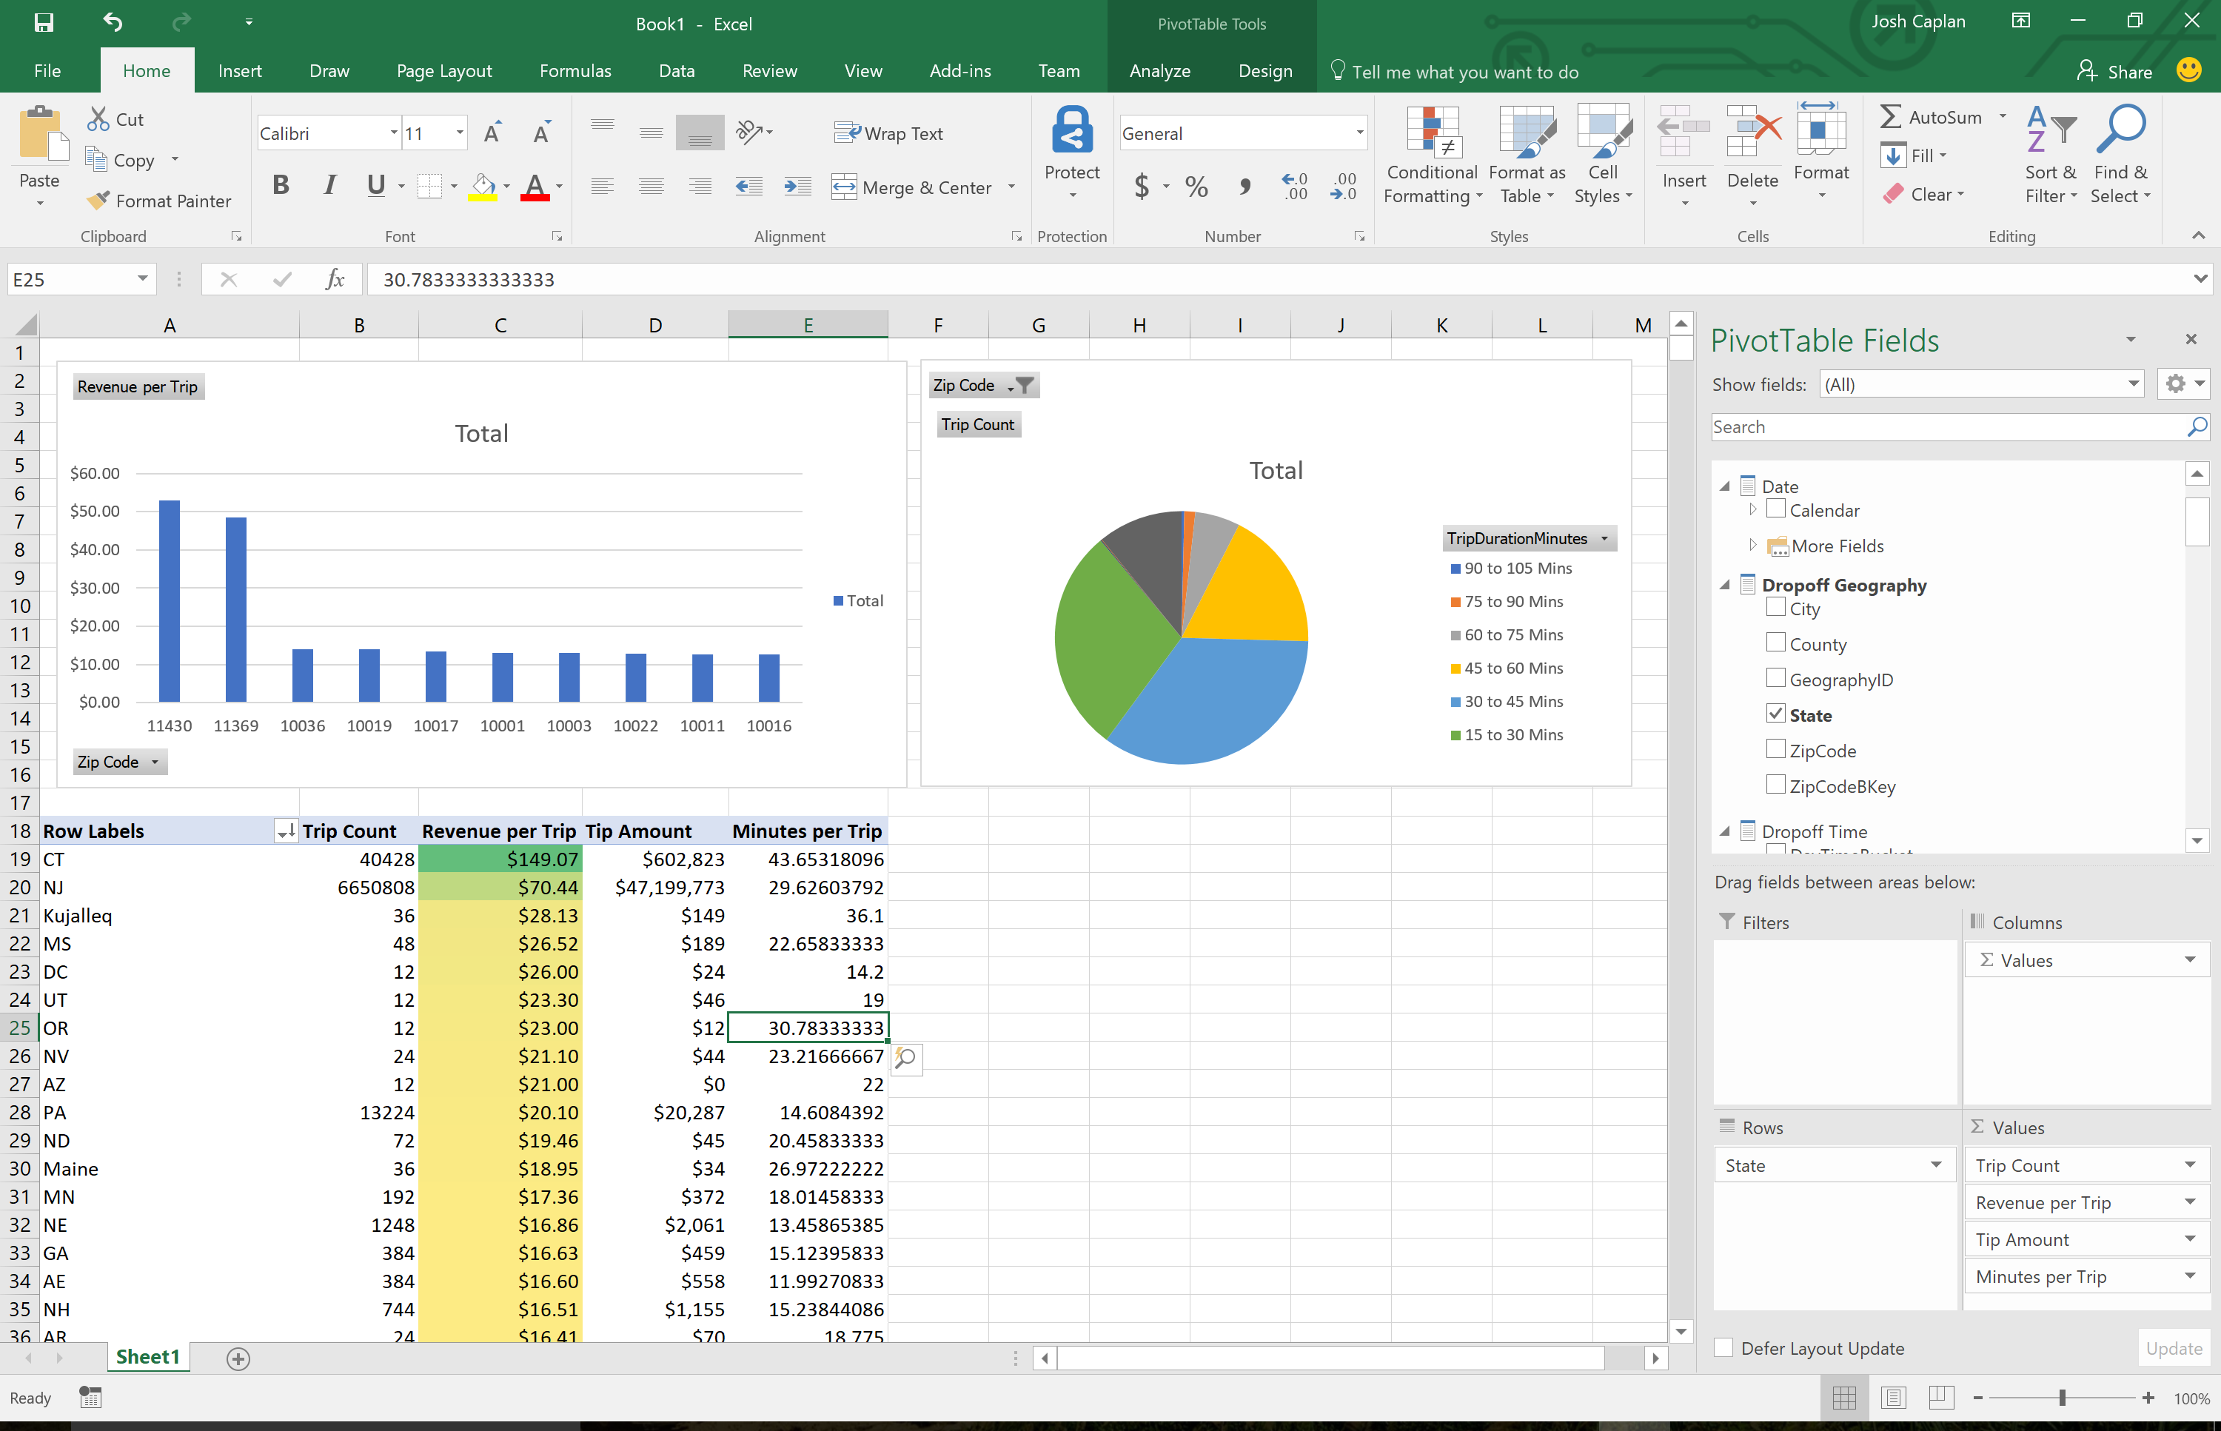
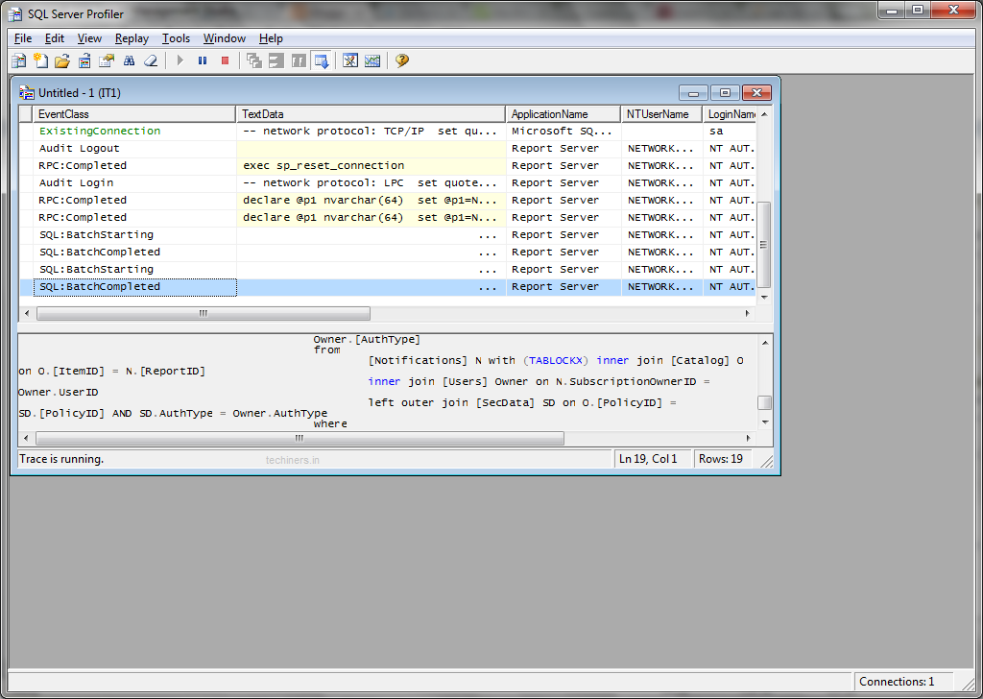
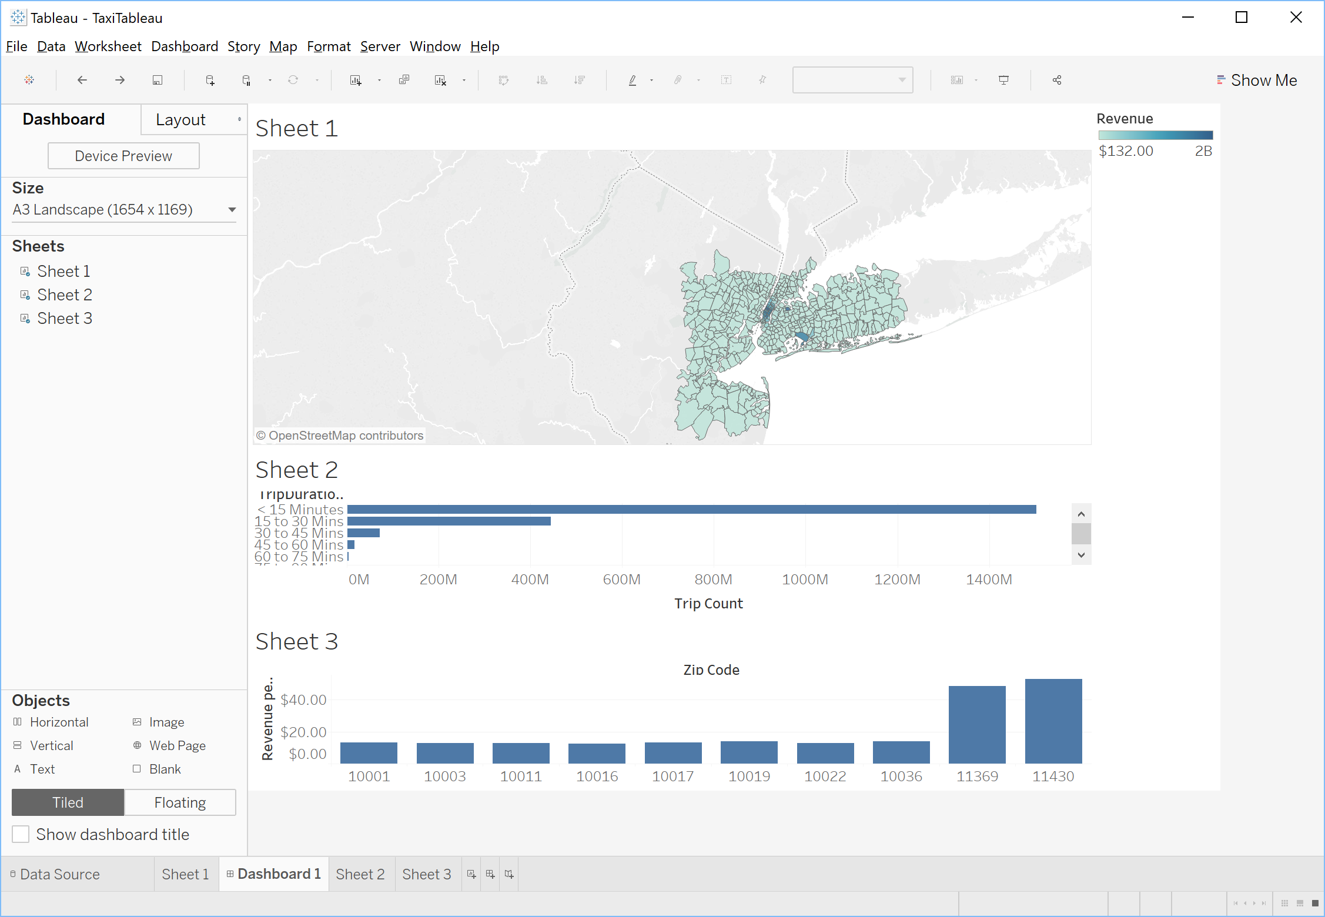
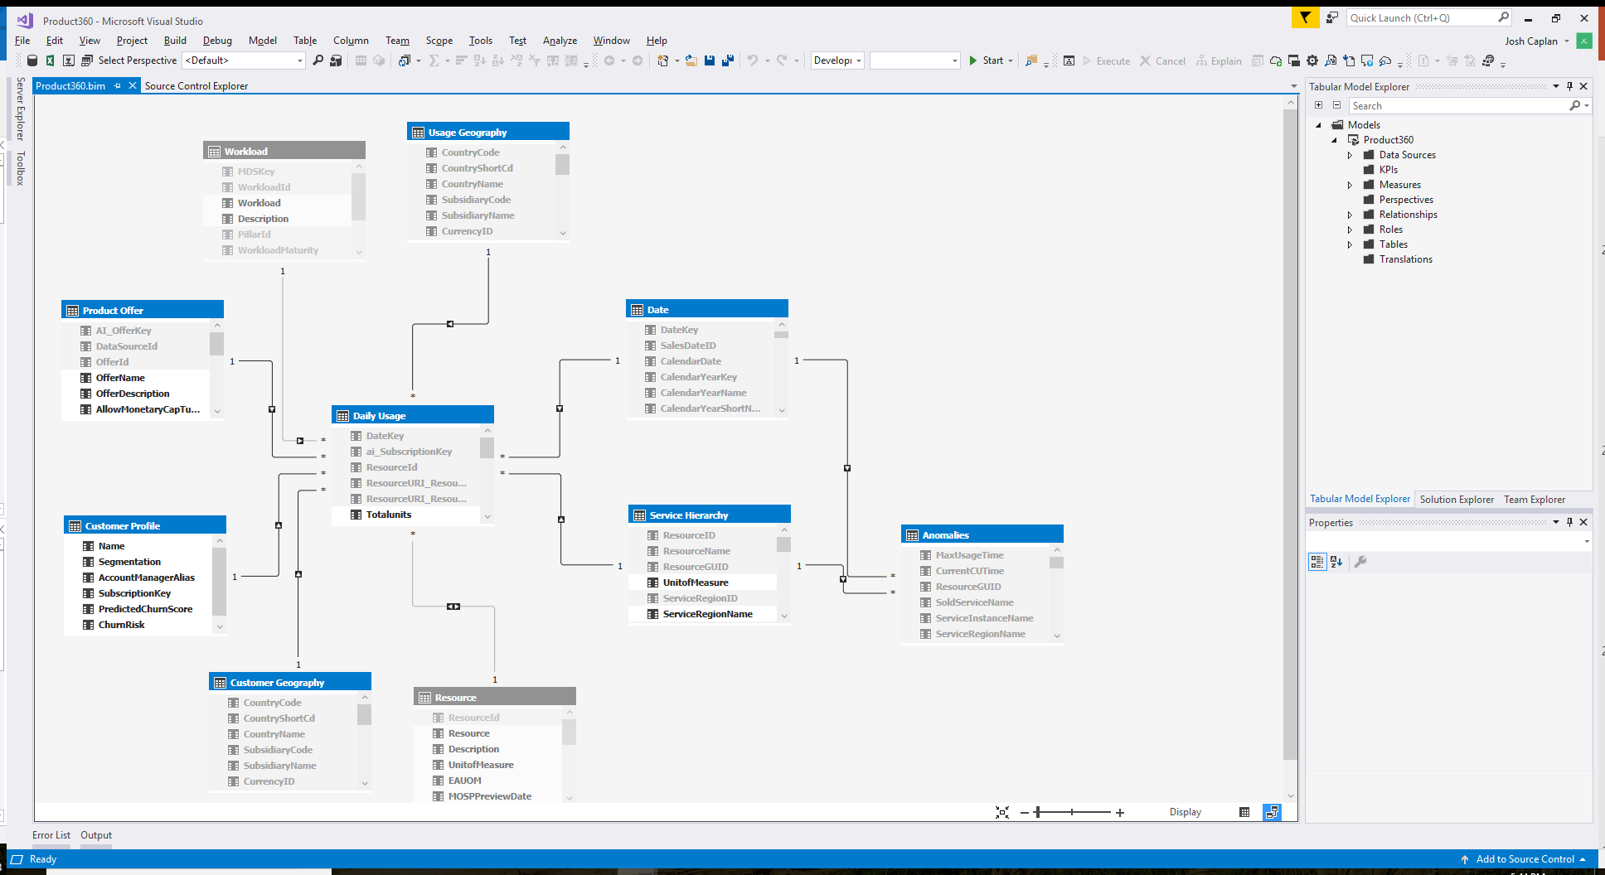
XMLA endpoints
Security
Data modeling
In-memory cache
Azure Analysis Services
Server
Workspace
Lifecycle management
Business logic & metrics
Notes:
At all times, the Power BI service strives to make the best use of capacity resources while not exceeding limits imposed on the capacity.
It is important to understand that interactive operations are always prioritized over background operations to ensure the best possible user experience.
If there are insufficient resources, background operations are added to a queue for processing when resources free up. Background operations, like dataset refreshes, can be stopped mid-process by the Power BI service and added to a queue.

Slide 21
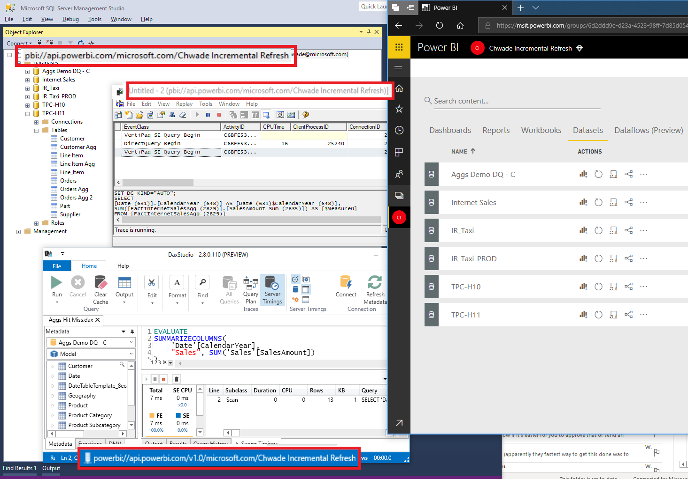

Slide 22
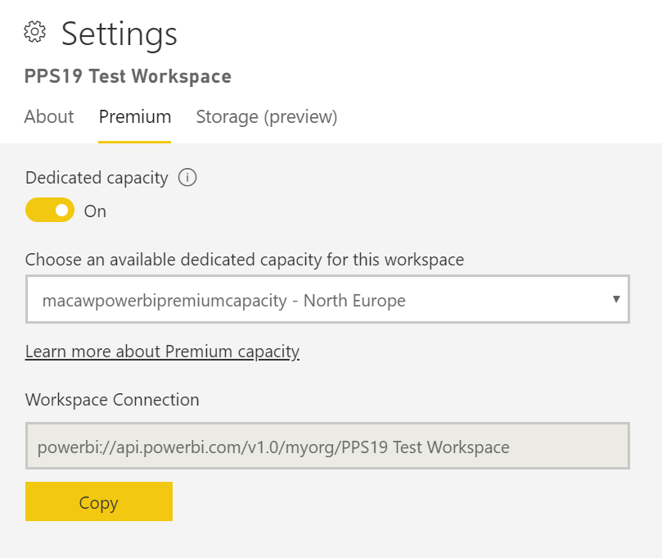

Slide 23
Under the hood of Premium Capacity
Notes:
Ask audience

Slide 24
Under the hood of Premium capacity
Capacity operations are classified as either interactive or background
Interactive operations include rendering requests and responding to user interactions (filtering, Q&A querying, etc.)
Imported model querying is generally memory resource-intensive
Querying LC/DQ models is generally CPU-intensive
Background operations include dataflow and import model refreshes, and dashboard query caching
Notes:
At all times, the Power BI service strives to make the best use of capacity resources while not exceeding limits imposed on the capacity.
It is important to understand that interactive operations are always prioritized over background operations to ensure the best possible user experience.
If there are insufficient resources, background operations are added to a queue for processing when resources free up. Background operations, like dataset refreshes, can be stopped mid-process by the Power BI service and added to a queue.

Slide 25
Overcommiting the capacity
Each capacity can store many import models (up to 100TB)
When their combined disk storage exceeds the supported memory, then they cannot all be loaded into memory at the same time and the capacity is overcommitted
Notes:
Import models are therefore loaded into - and removed from - memory according to usage. An import model is loaded when it is queried (interactive operation) and not yet in memory, or when it is to be refreshed (background operation).

Slide 26
Evictions from memory (1)
If the capacity is not experiencing any memory pressure, models are simply loaded into memory and remain there
When insufficient memory is available to load a model, the Power BI service will first need to free up memory
The removal of a model from memory is known as eviction
Notes:
Import models are therefore loaded into - and removed from - memory according to usage. An import model is loaded when it is queried (interactive operation) and not yet in memory, or when it is to be refreshed (background operation).

Slide 27
Evictions from memory (2)
Power BI will first try to detecting models that have become inactive by seeking models which have not been used in the last three minutes
If there are no inactive models to evict, the Power BI service seeks to evict models loaded for background operations
A last resort, after 30 seconds of failed attempts, is to fail the interactive operation of the current user
Notes:
*timings can change

Slide 28
Evictions from memory (3)
Dataset eviction
==
normal and expected behavior
Notes:
It is important to stress that dataset eviction is a normal and expected behavior. It strives to maximize memory usage by loading and unloading models whose combined sizes can exceed available memory. This is by design, and completely transparent to report users. High eviction rates do not necessarily mean the capacity is insufficiently resourced. They can, however, become a concern if query or refresh responsiveness is suffering because of high eviction rates.

Slide 29
Dataset refreshes
Dataset refreshes are memory intensive and use ±2x RAM
Scheduled dataset refresh will be queued if there is insufficient memory and all models are active (no evictions possible)
On-demand refreshes (triggered by a user request or API call) will retry three times, and then fail if there are still not enough resources

Slide 30
Under the hood of Premium capacity
Capacity: P1
Backend v-cores: 4
Memory: 25 GB
Storage: 100 TB
25 GB Memory
100 TB storage
Dataset 1
Dataset 2
Dataset 3
Dataset 4
Dataset 5
Dataset 6
Dataset 7
Dataset 8
Dataset 9
Dataset 10
Dataset 11
Dataset 12
Dataset 13
Dataset 14

Slide 31
Under the hood of Premium capacity
Capacity: P1
Backend v-cores: 4
Memory: 25 GB
Storage: 100 TB
25 GB Memory
Temperature: Cool
Dataset 1
Dataset 2
Dataset 3
100 TB storage
Dataset 1
Dataset 2
Dataset 3
Dataset 4
Dataset 5
Dataset 6
Dataset 7
Dataset 8
Dataset 9
Dataset 10
Dataset 11
Dataset 12
Dataset 13
Dataset 14

Slide 32
What happens when the capacity is out of resources…

Slide 33
Eviction
Capacity: P1
Backend v-cores: 4
Memory: 25 GB
Storage: 100 TB
25 GB Memory
Dataset 1
Dataset 2
Dataset 3
Dataset 4
Dataset 5
Dataset 6
Temperature: Warm
100 TB storage
Dataset 1
Dataset 2
Dataset 3
Dataset 4
Dataset 5
Dataset 6
Dataset 7
Dataset 7
Dataset 8
Dataset 9
Dataset 10
Dataset 11
Dataset 12
Dataset 13
Dataset 14

Slide 34

How many refreshes at one time?
Capacity: P1
Backend v-cores: 4
Memory: 25 GB
Storage: 100 TB
25 GB Memory
Dataset 1
Dataset 2
Dataset 3
Dataset 4
Dataset 5
Dataset 6
Queue
100 TB storage
Dataset 1
Dataset 2
Dataset 3
Dataset 4
Dataset 5
Dataset 6
Dataset 7
Dataset 7
Dataset 8
Dataset 9
Dataset 10
Dataset 11
Dataset 12
Dataset 13
Dataset 14

Slide 35
How many refreshes at one time?
Capacity: P1
Backend v-cores: 4
Memory: 25 GB
Storage: 100 TB
25 GB Memory
Temperature: Warm
Dataset 1
Dataset 2
Dataset 3
Dataset 4
Dataset 5
Dataset 6
Queue
100 TB storage
Dataset 7
Dataset 1
Dataset 2
Dataset 3
Dataset 4
Dataset 5
Dataset 6
Dataset 7
Dataset 8
Dataset 9
Dataset 10
Dataset 11
Dataset 12
Dataset 13
Dataset 14

Slide 36
What if my capacity is heavily used…

Slide 37

Background vs interactive operations..
Capacity: P1
Backend v-cores: 4
Memory: 25 GB
Storage: 100 TB
25 GB Memory
Temperature: Hot
Dataset 1
Dataset 2
Dataset 3
Dataset 4
Dataset 5
Dataset 6
Queue
100 TB storage
Dataset 1
Dataset 2
Dataset 3
Dataset 4
Dataset 5
Dataset 6
Dataset 7
Dataset 7
Dataset 8
Dataset 9
Dataset 10
Dataset 11
Dataset 12
Dataset 13
Dataset 14

Slide 38
All interactive operations…
Capacity: P1
Backend v-cores: 4
Memory: 25 GB
Storage: 100 TB
25 GB Memory
Temperature: Burning
Dataset 1
Dataset 2
Dataset 3
Dataset 4
Dataset 5
Dataset 6
Queue
100 TB storage
Dataset 8
Dataset 9
Dataset 1
Dataset 2
Dataset 3
Dataset 4
Dataset 5
Dataset 6
Dataset 7
Dataset 7
Dataset 10
Dataset 8
Dataset 9
Dataset 10
Dataset 11
Dataset 12
Dataset 13
Dataset 14

Slide 39
Power BI Premium Management
Notes:
Ask audience:

Slide 40
Power BI Premium Management
Creating and Managing Capacities
Assigning Workspaces to Capacities
Monitoring Capacities
Optimizing Premium Capacities

Slide 41
Creating and Managing Capacities
The Capacity Settings page of the Power BI Admin Portal displays the number of v-cores purchased and available (i.e. yet to be assigned to a capacity)
Each capacity has its won set of admins
Capacity Admins cannot access workspace content
A Premium capacity can be assigned to a region other than the home region of the Power BI tenant (multi-geo)
You can specify the memory per workload (default stuff, dataflows, paginated reports)
Notes:
Users assigned as Capacity Admins can assign workspaces to the capacity, manage user permissions, workloads, restart the capacity.
Memory is dynamically allocated to dataflows, but it is statically allocated to paginated reports. The reason for statically allocating the maximum memory is that paginated reports run within a secured contained space of the capacity. Care should be taken when setting paginated reports memory as it reduces available memory for loading models.

Slide 42
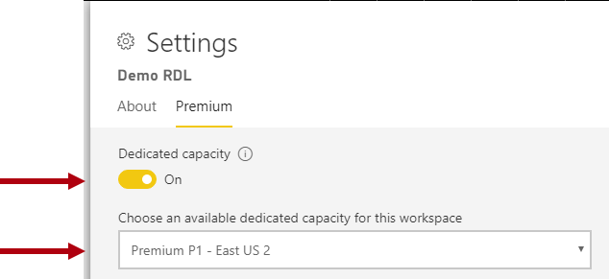
Assigning Workspaces to Capacities
Assign workspaces manually
Bulk assign:
Workspaces by users
Specific workspaces
The entire organization's workspaces

Slide 43
Monitoring Capacities
Power BI Admin Portal (basic)
Power BI Premium Capacity Metrics App, including:
Average CPU and high utilization count
Average Memory and high utilization count, and memory usage for specific datasets, dataflows and paginated reports
Active datasets loaded in memory
Average and maximum query durations
Average query wait times
Average dataset and dataflow refresh times

Slide 44
Demo!
Monitoring Premium capacity

Slide 45
Optimizing Premium Capacities
Separate business critical and Self-Service BI (SSBI) into different capacities
Check if sharing is only with Power BI Pro users, there may be no need to store content in Premium capacity
Use Premium when looking to achieve a specific refresh time
Use Premium when specific features are required, for example large datasets or paginated reporting
Optimize your Data Models

Slide 46
Sizing your capacities
Model size and data characteristics
Concurrent active models
Import model refresh
Concurrent queries
Other workloads: dataflows and paginated reports
Priority (business-critical vs self-service)
Generally, for larger models you scale up, for more concurrency you scale out
Consider splitting a P2, before upgrading to P3
Test the waters using Azure Power BI Embedded Capacity
Notes:
Determining the size and number of Premium capacities can be challenging, especially for the initial capacities you create. The first step when capacity sizing is to understand the average workload representing expected day-to-day usage. It is important to understand that not all workloads are equal. For example - at one end of a spectrum - 100 concurrent users accessing a single report page that contains a single visual is easily achievable. Yet - at the other end of the spectrum - 100 concurrent users accessing 100 different reports, each with 100 visuals on the report page, is going to make very different demands of capacity resources.
Capacity Admins will therefore need to consider many factors specific to your environment, content and expected usage. The overriding objective is to maximize capacity utilization while delivering consistent query times, acceptable wait times, and eviction rates. Factors for consideration can include these.
Memory is dynamically allocated to dataflows, but it is statically allocated to paginated reports.
In addition to these factors, Capacity Admins can consider creating multiple capacities. Multiple capacities allow for the isolation of workloads and can be configured to ensure priority workloads have guaranteed resources. For example, two capacities can be created to separate business-critical workloads from self-service BI (SSBI) workloads. The business-critical capacity can be used to isolate large corporate models providing them with guaranteed resources, with authoring access granted only to the IT department. The SSBI capacity can be used to host a growing number of smaller models, with access granted to business analysts. The SSBI capacity may at times experience query or refresh waits that are tolerable.

Slide 47
Power BI Premium or Azure Analysis Services
Notes:
It’s one of the questions I get asked most often these days.
Besides the other question of course: “Which data flow solution are you talking about?” Power BI / ADF / SSIS…
What is the difference between Power BI Premium and Azure Analysis Services, and how do I select the service that fits my needs best?

Slide 48


Power BI Premium or Azure Analysis Services
Power BI Premium 💎
Policy-based incremental refresh
Scheduled refresh
Composite models & aggregations
More connectors
PBI Desktop
…
Power BI
Analysis Services
Azure Analysis Services
Notes:
Todo: verhaal bij deze slide!

Slide 49

Power BI Premium or Azure Analysis Services
*State of March 2019*
DevOps experience
Killer features (Object Level Security / Translations / Composit Model)
One model “to rule them all”
Version control
Data Source Connectivity
Front-end tooling
Very large model support
User group characteristics
Notes:
Emphasize that these points will change VERY soon.
Comparing the DevOps experience between these two services. Ask yourself: “can the model be built by people comfortable with Visual Studio, SSMS and scripting”?
Killer features required?
Require a single model, that will be leveraged by multiple audiences? (this would currently require multiple App Workspaces and duplication of data)
Need tight version control on your model? Controls to compare to previous or production-server versions?
Do you need to load data from any of these sources: SAP / Azure Storage / Azure HDInsight / Databricks? This requires Power Query to load data. Although AAS supports this, the experience in Power BI is much (!) better.
Do you need to connect to the data model with tools like Tableau, SSRS, etc?
Do you need support for very large models? Can’t use composit model with aggregatons?
Do you have more than 300 users who interactively view your data models?

Slide 50
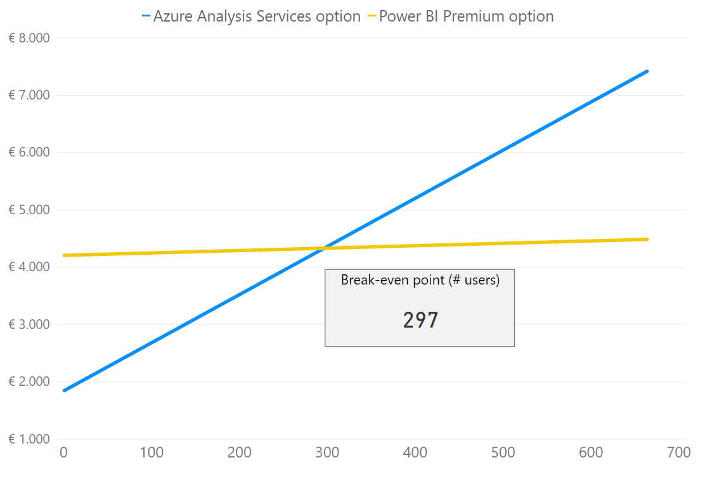
Power BI Premium vs Azure Analysis Services
Premium💎scenario
1x P1 license = €4.200
5% of users are also creators and need a Pro licence (€8,40)
Analysis Services scenario
DevTest = 1x S1 during working hours
Prod = 1x S1 24/7, with S2 upscale on peak hours and processing windows
Each user requires a Pro licence
Notes:
Free user can’t use dataflows.

Slide 51
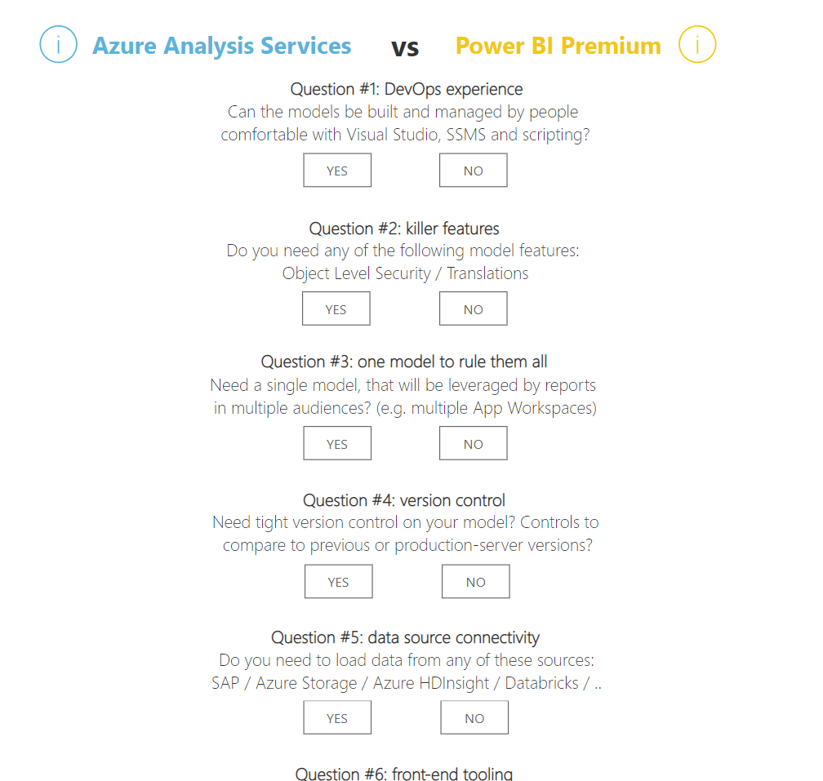
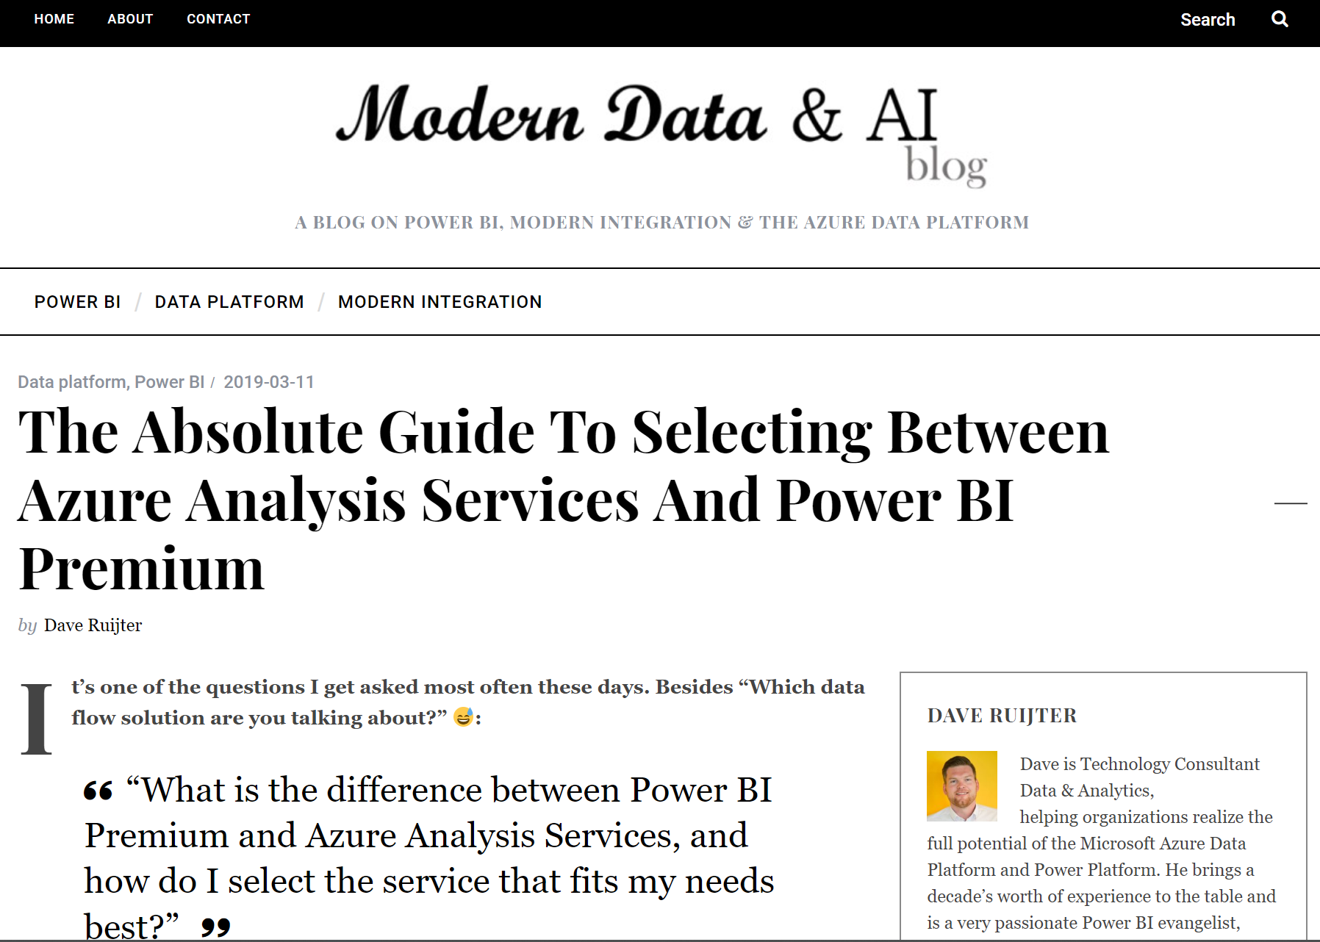
Power BI Premium vs Azure Analysis Services
https://www.moderndata.ai/aasvspbi

Slide 52
Power BI Premium AI features
Notes:
Todo: kijken of ik hier nog de demo kan geven over de AI features (die Premium zijn)

Slide 53
AI features in Power BI Premium
Invoke Cognitive Services to enrich your data
Create new Machine Learning models with AutoML
Easily invoke your Azure Machine Learning models (premium not required)
Notes:
Cognitive Services will require Premium, but there will be no other charges.
Azure ML will be available for Pro users, and will not require Premium.
AutoML will require Premium.

Slide 54
Demo!
Power BI Premium AI features

Slide 55
Roadmap for Power BI Premium
Calculation Groups
XMLA endpoints write-enabled
Paginated Reports GAA
Notes:
Todo: roadmap opzoeken

Slide 56
Session resources
My blog post on selecting between Power BI Premium and Azure Analysis Services:
Power BI Premium on public Microsoft sites:
Premium documentation: https://docs.microsoft.com/en-us/power-bi/service-premium
Premium whitepaper: https://docs.microsoft.com/en-us/power-bi/whitepaper-powerbi-premium-deployment
Premium roadmap / release notes:
Premium on Power BI Ideas:
Notes:
Todo: deze nog aanpassen!

Slide 57
Download for free!
https://bit.ly/cheatsheetpbi

